Slide 1
How to get the most out of Power Query
Thomas Foster

Slide 2




What is Power Query?
Power BI
Data
Excel
Images from wikimedia
Notes:
Hands who has heard of Power Query or used it?
Excel – Power BI – SSAS 2017 – Flow
Focus on Power BI but applicable across Excel SSAS 2017 and sort of flow One of the core components of Power BI desktop along with data model
Often under looked how agnostic it is about data source

Slide 3
Demo 1
Notes:
Basics of power query load single file
Get Data -> not load but edit, then enable formula bar
Data recipe
Ribbons across the top then recap

Slide 4
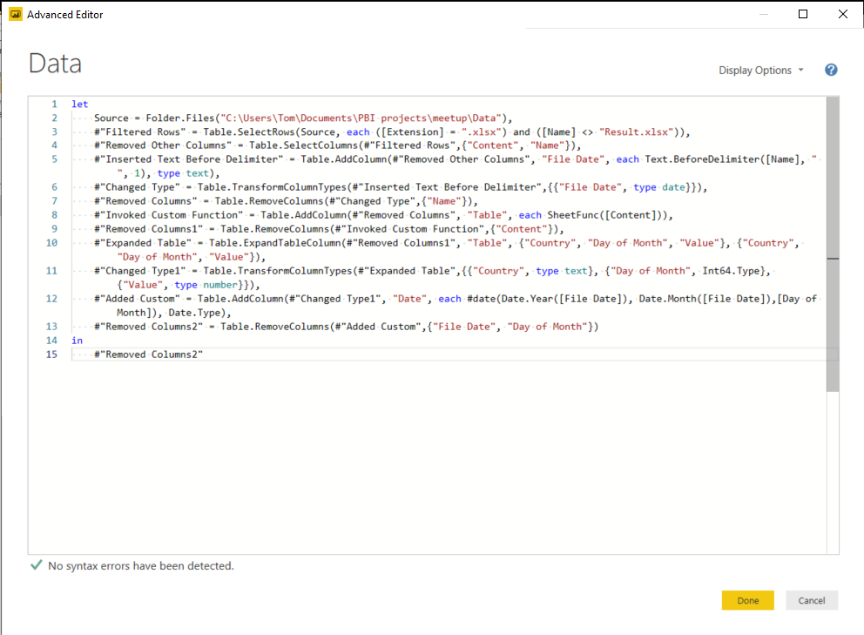
What is “M”?
M is the language that sits behind Power Query
Automatically created by Power Query UI
LOOKS SCARY!
Very Powerful once you start to understand it
Notes:
Everything done so far with UI Language behind power query created by UI. If you have used any part of power query before you have written M
Reiterate enabling formula bar
It does look scary if, understand it is step based. Best way to learn is to use the UI and start to tweak what the UI writes.
Once you understand a little bit it very powerful

Slide 5
Demo 2
Notes:
Load from folder
Possible on any data source with nested data

Slide 6
When do I use M or DAX?
True but useless answer: It depends.
Use M to reduce the volume of data loaded into the model
When transforming data, play to each languages strengths!
When adding columns M can perform better than DAX
Notes:
Question asked a lot
Use where their strengths lie M text manipulation, unpivot.
DAX Time intelligence, relationship navigation.
If both use in M as more performant. But don’t get caught up in this for small/medium models. Do what you need to get the model into a better schema.
Performance improvement out of scope

Slide 7
Demo 3
Notes:
Add custom column, first by typing, second through let statement Only If time
Start looking more into M
Do let statements in custom column Data types, lists, scalars, tables, records

Slide 8
Where to learn more?
blog.crossjoin.co.uk thebiccountant.com powerquery.training
fosterbi.co.uk
Notes:
Good power query blogs cross join – chris webb
Bi accountant imke Feldman
Power query training
My blog

Slide 9
Thank you!
Twitter - @ThomasFosterrrr Linkedin - linkedin.com/in/twfoster/ Email – Thomas@FosterBI.co.uk

